Slide 1
ElePay Group 3
Object-Oriented Software Engineering Team Work – 2
A10723029 Natalia
A10723035 Sunny
A10723011 Bryan
A10723026 Elian
A10723044 Ricky
B10523039 Jess
B10523019 Jason
B10523030 Jerry

Slide 2
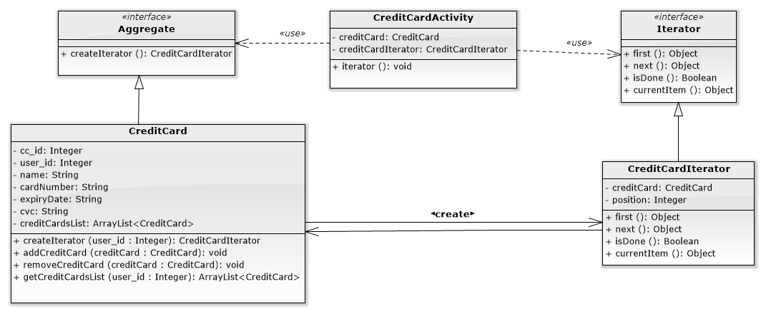
Iterator combines with Factory Method
The user can have more than one credit card in Elepay. So the Iterator Pattern can iterate every credit card that user has, then we can know how many credit card user has.

Slide 3
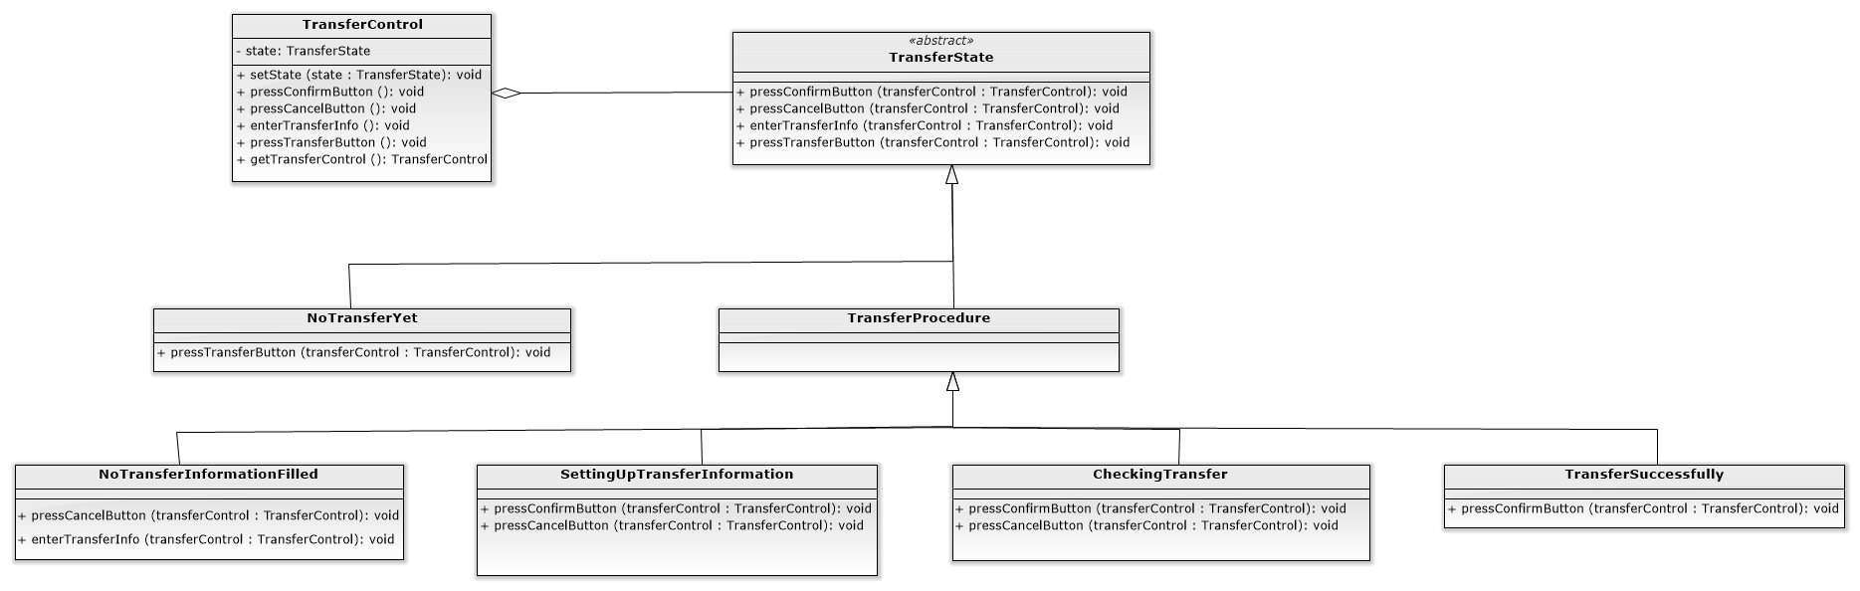
State
There’ll be several states changes when the users are making a transfer. We want to let the users know which step they’re currently at, so we use the State Pattern to present the status change to user.

Slide 4
State (cont.)
We have five state in Transaction and there’re four events:
State Substate \ Event |  | Press Confirm Button | Press Cancel Button | Enter Transfer Info. | Press Transfer Button
No Transfer Yet (Init) |  | NA | NA | NA | Transfer Procedure
Transfer Procedure | No Transfer Information Filled (Init) | NA | No Transfer Yet | Setting up transfer information | NA
 | Setting Up Transfer Information | Checking transfer | No Transfer Information Filled | NA
 | Checking Transfer | Transfer Successfully / send email | Setting Up Transfer Information | NA
 | Transfer Successfully | No Transfer Yet | NA | NA

Slide 5
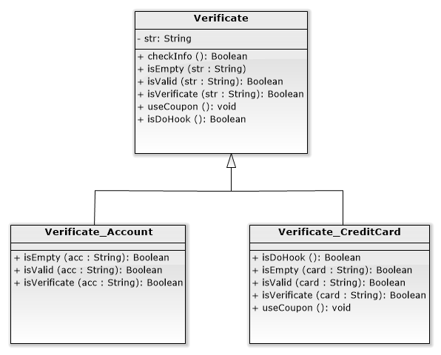
Template
We have two transaction method: Credit in ElePayAccount or Credit Card, and they have the same verification process.

Slide 6
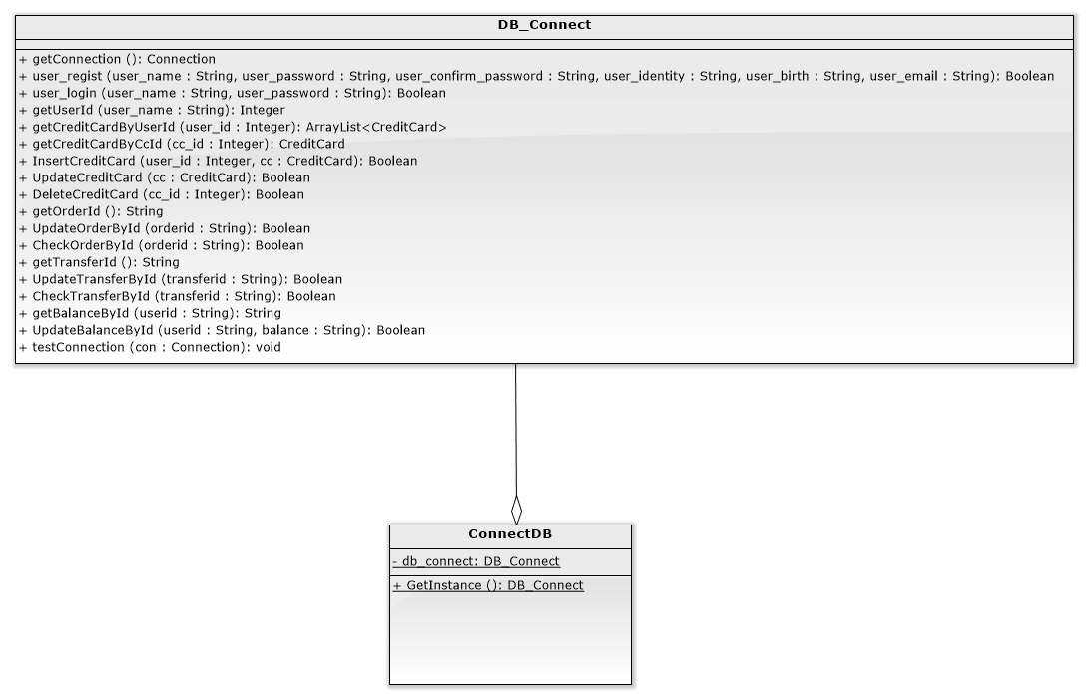
Singleton
We can have only one DB object, the Singleton Pattern can make the DB object as a unique access point when connecting to database.

Slide 7
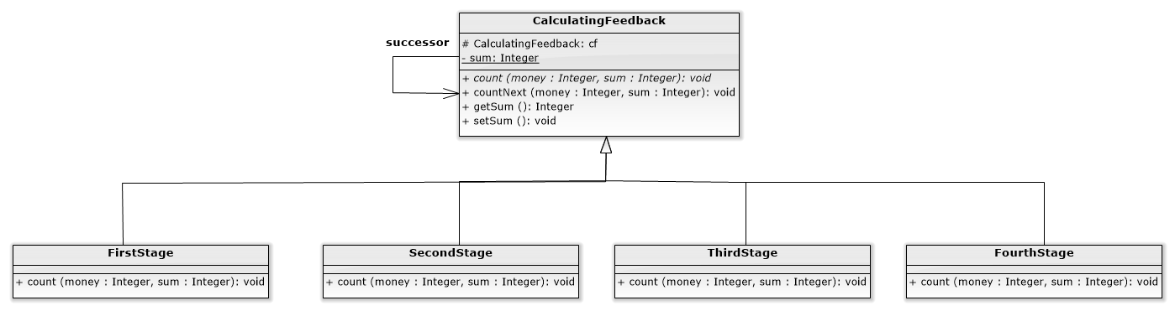
Chain of Responsibility
The Chain of Responsibility can help give the amount of credits to customer according to their bill. The credit is calculated in the table below.
Consumption | Credits
$0 ~ $7,500 | 5%
$7,501 ~ $15,000 | 10%
$15,001 ~ $22,500 | 15%
$22,501 ~ $30,000 | 20%

Slide 8
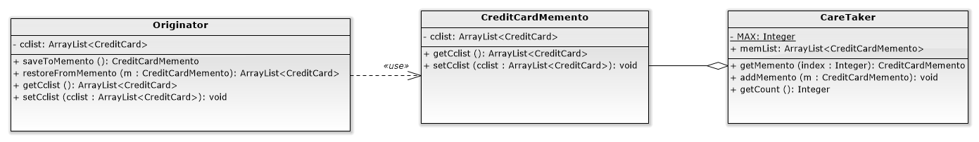
Memento
We want CreditCard to perform the redo and undo functions when adding, modifying, and deleting.

Slide 9
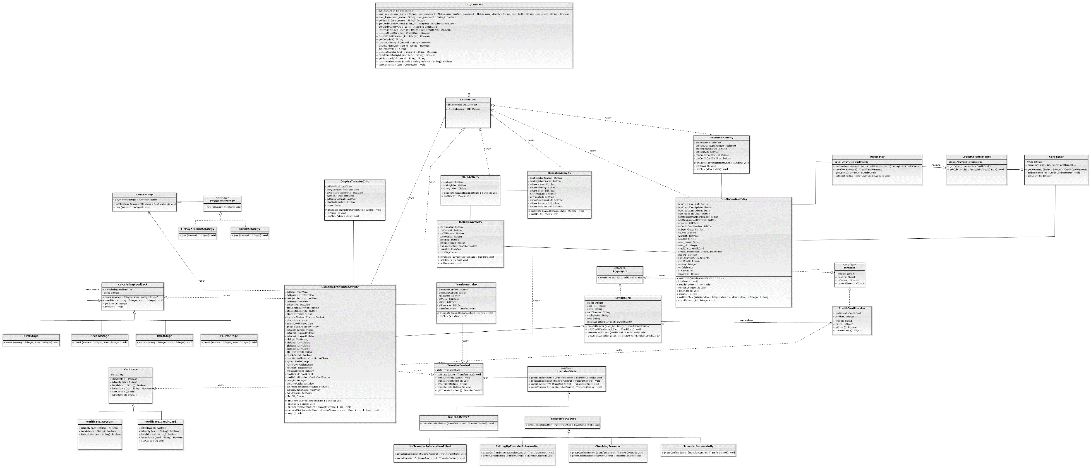
Big class diagram

Slide 10
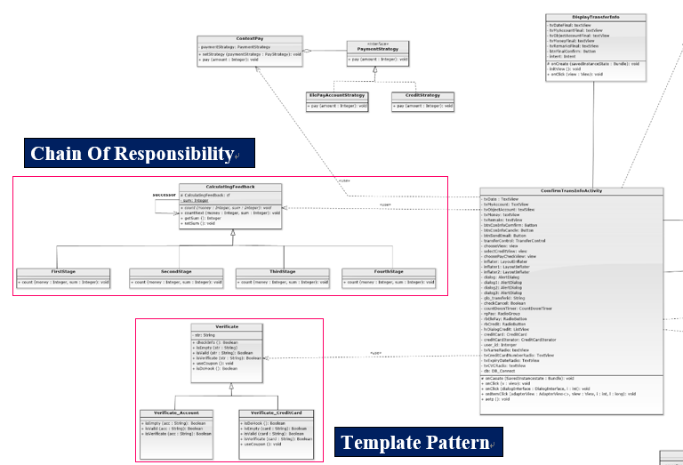

Slide 11
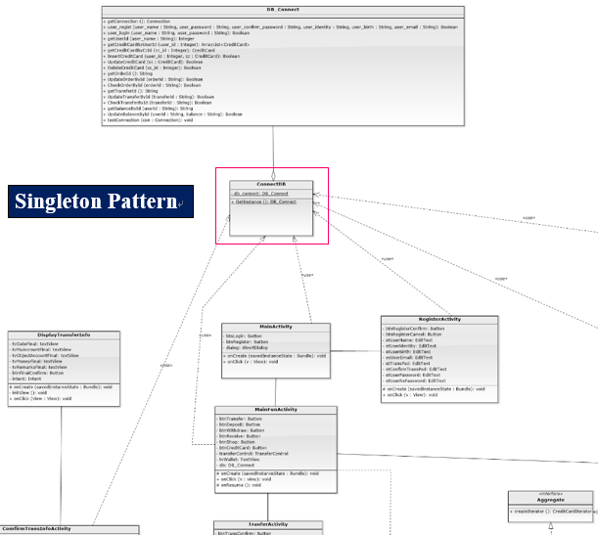

Slide 12
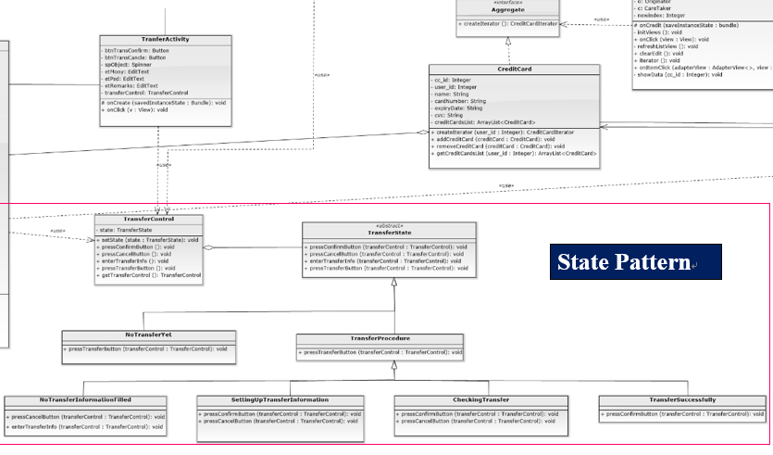

Slide 13
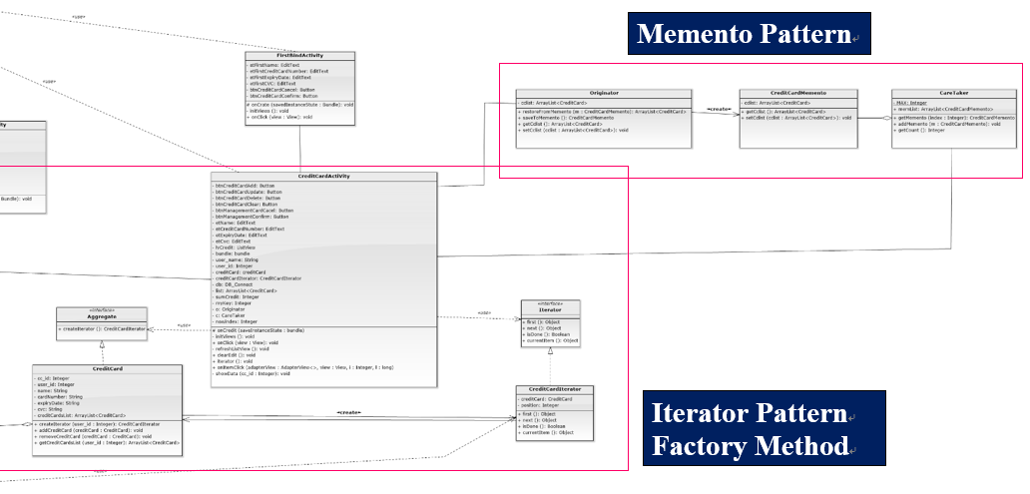

Slide 14
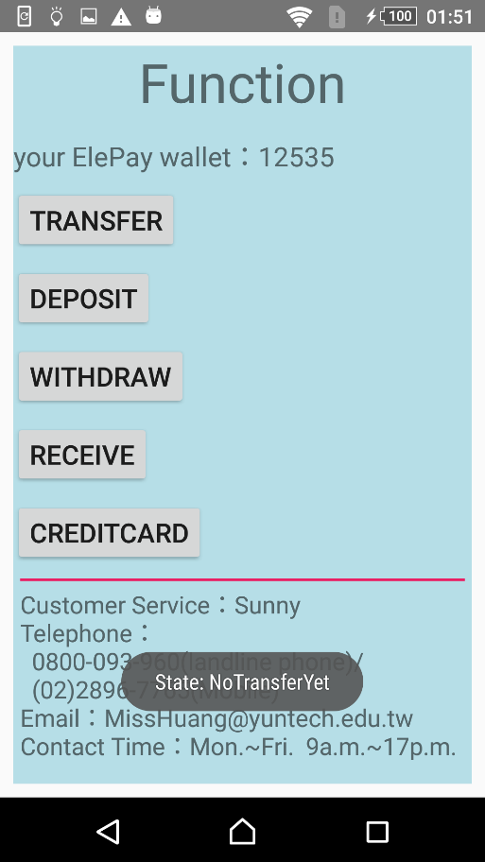
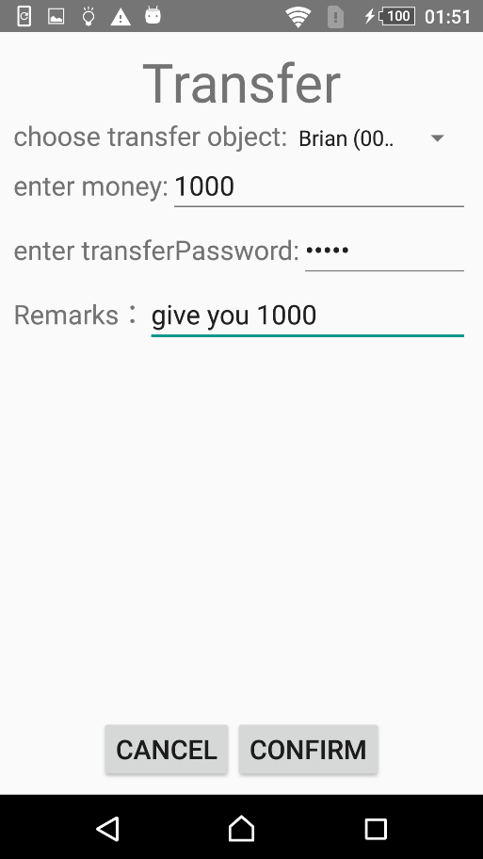
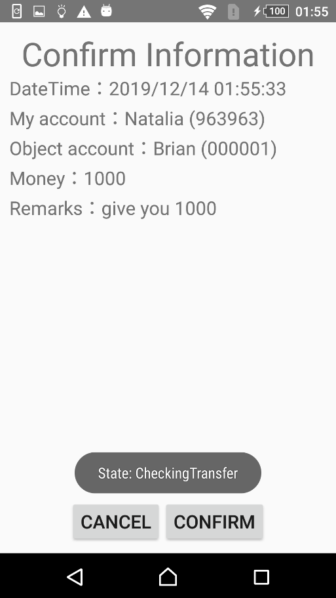
NoTransferYet
enter transfer info.
CheckingTransfer

Slide 15
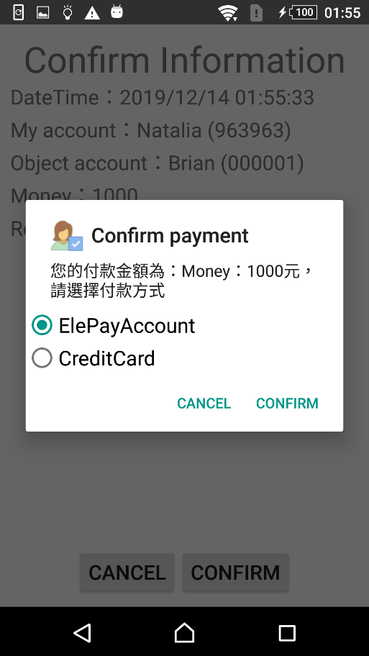
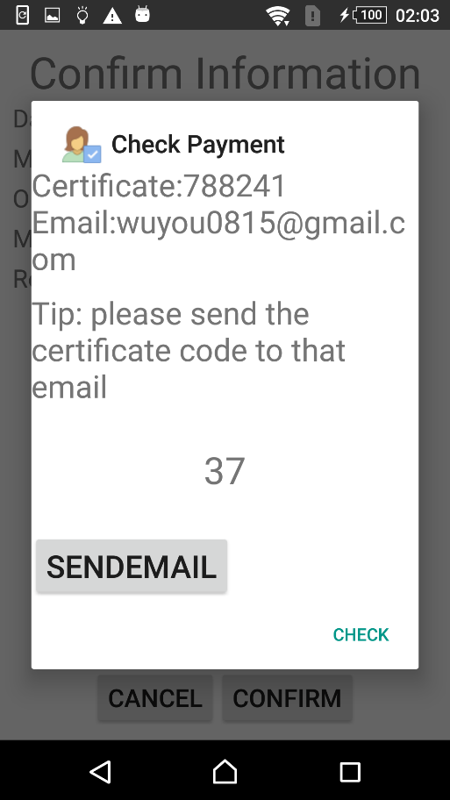
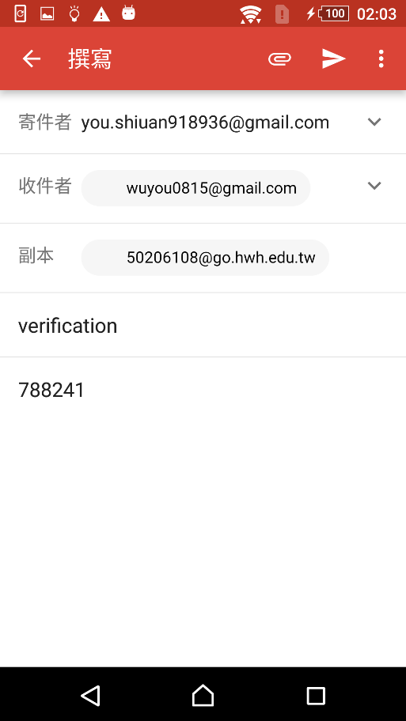
(1)choose ElePayAccount
AOTP verification
send email

Slide 16
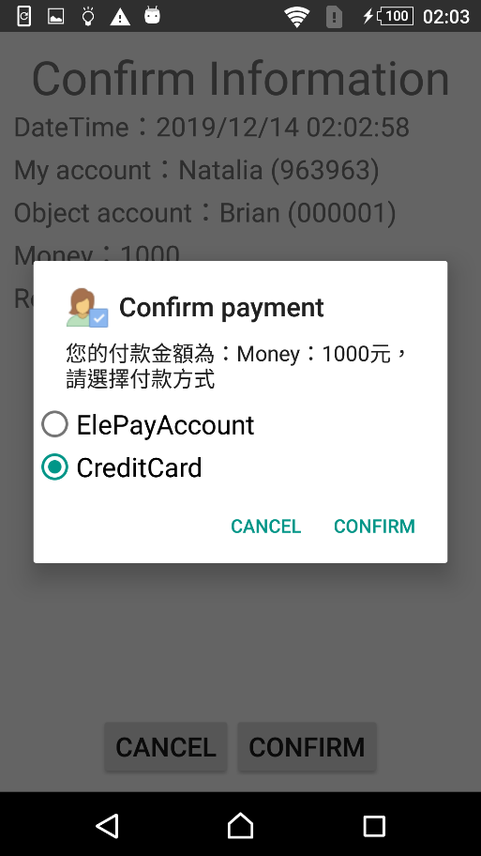
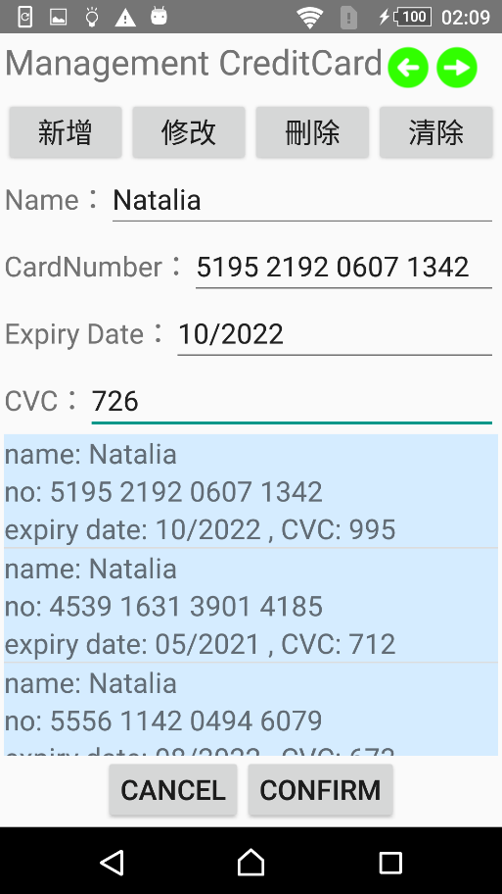
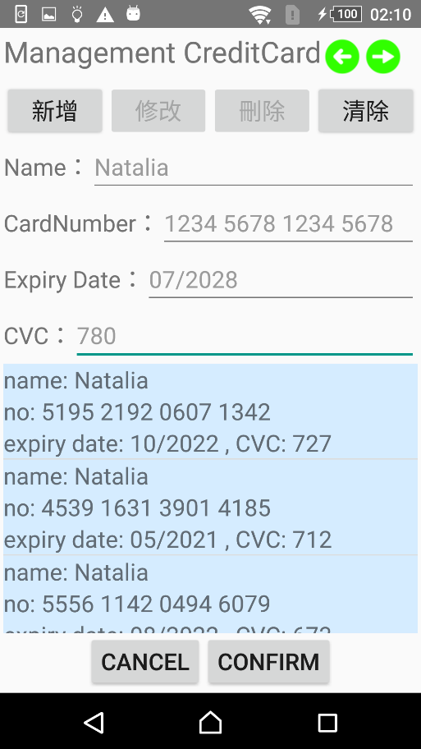
(2) choose CreditCard
select item
memento undo

Slide 17
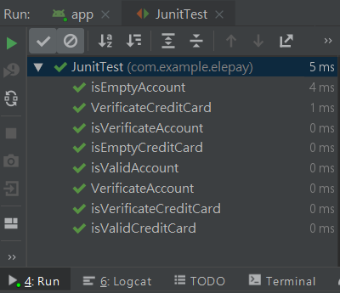
Junit test & Code
Junit test result

Slide 18
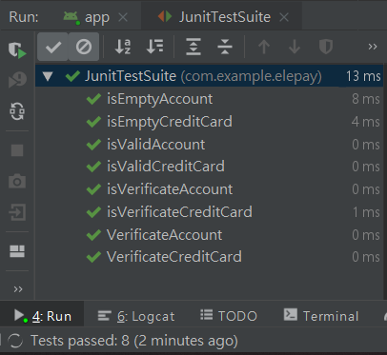
Junit test suite & Code
Junit test result

Slide 19
Black box
Equivalence Partitioning
Equivalence partitioning divides the input and output domains into a number of disjoint subsets, and selects one test case from each of these disjoint subsets.
In ElePay, users have an account, when they transfer money, the transfer amount cannot over 30,000. According to our transfer amount regulation, we set the Equivalence Partitioning Testing as below:：
Partition 1(the transfer amount equal and less than 30,000)
First subset consists of the transfer amount equal and less than 30,000. The test cases in this partition will be accepted.
Partition 2(the transfer amount greater than 30,000)
Second subset consists of the transfer amount greater than 30,000. The test cases in this partition will be rejected.

Slide 20
Black box
Boundary Value Analysis
The boundary value analysis selects test cases at near the boundaries of the equivalence classes.
Suppose that “transfer amount” is “TM”.
For Partition1(the transfer amount equal and less than 30,000), the test cases are
{TM = 29999, TM= 30000, TM = 30001}

Slide 21
White box
Basis Path Testing
Basis path testing generates test cases to exercise to exercise the independent control flow paths, called basis paths, of the CUT.
@Override public void onClick(View view) { 1 switch (view.getId()){ case R.id.btnShopPayment: 2 String strDC = ""; 3 String strGC = ""; 4 if(cbDC.isChecked()){ 5 ComputerBuilder computerBuilder = new DocumentComputerBuilder(); 6 ComputerDirector director = new ComputerDirector(computerBuilder); 7 director.build(); 8 Computer DC = computerBuilder.getComputer(); 9 strDC = DC.display(); 10 } 11 else(cbGC.isChecked()){ 12 ComputerBuilder computerBuilder = new GamingComputerBuilder(); 13 ComputerDirector director = new ComputerDirector(computerBuilder); 14 director.build(); 15 Computer GC = computerBuilder.getComputer(); 16 strGC = GC.display(); 17 } 18 Intent intent = new Intent(this, PayActivity.class); 19 intent.putExtra("total", sum); 20 intent.putExtra("strDC", strDC); 21 intent.putExtra("strGC", strGC); 22 startActivity(intent); 23 break; case R.id.btnShopCancel: 24 finish(); 25 break; default: 26 Toast.makeText(this, "default", Toast.LENGTH_SHORT).show(); 27 }

Slide 22
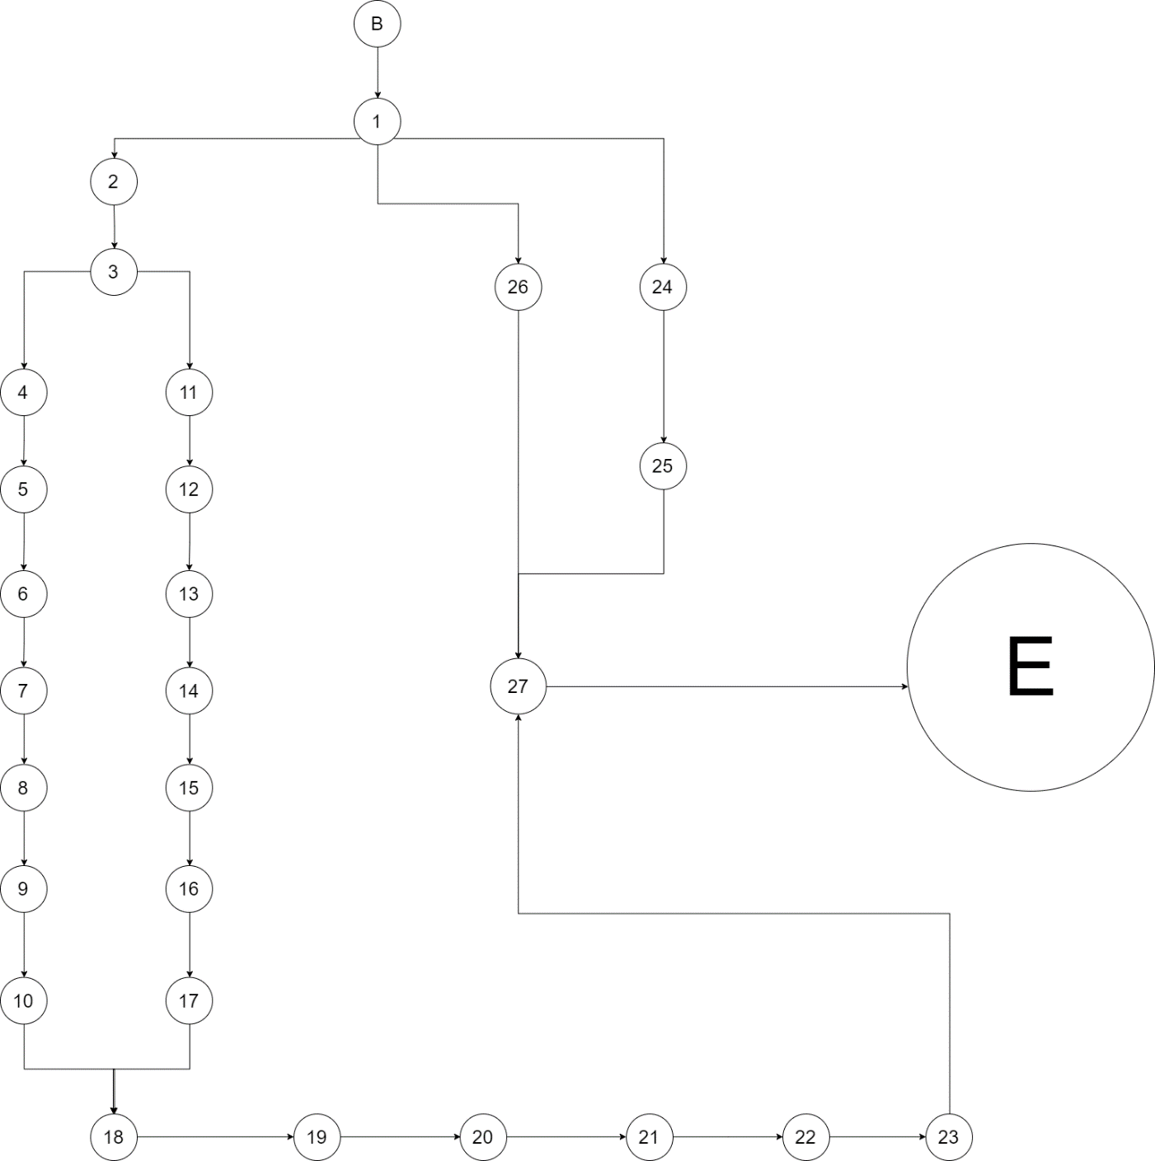
White box
Basis Path Testing
A basis path is a path from the B node to the E node and exercises a directed cycle at most once.
This definition produces four basis paths for the onClick() method using its flow graph:
(1) B→1→2→3→4→5→6→7→8→9→10→18→19→20→21→22→23→27→E
(2) B→1→2→3→11→12→13→14→15→16→17→18→19→20→21→22→23→27→E
(3) B→1→2→24→25→27→E
(4) B→1→2→26→27→E

Slide 23
White box
Cyclomatic Complexity
1. Number of closed regions plus one.
This approach obtains the cyclomatic complexity by adding one to the number of closed regions in the flow graph.
【cyclomatic complexity is 3 + 1 = 4.】
2. Number of nodes and edges.
In this approach, the cyclomatic complexity is the number of edges minus the number of nodes plus 2.
According to the flow graph have eighteen edges and sixteen nodes
【cyclomatic complexity is 31 – 29 + 2 = 4.】
3. Number of atomic binary conditions plus one.
The cyclomatic complexity is the number of atomic binary conditions plus 1.
According to the flow graph have three atomic binary conditions(1 and 3 and 12) 【cyclomatic complexity is 3 + 1 = 4.】

Slide 24
Invocation chains
Invocation chains in the ElePay (teamwork2)
Invocation Chain Length | 1 | 2 | 3
Number of chains | 41 | 15 | 20
Invocation chains in the ElePay (teamwork1)
Invocation Chain Length | 1 | 2 | 3 | 4
Number of chains | 32 | 11 | 5 | 3

Slide 25
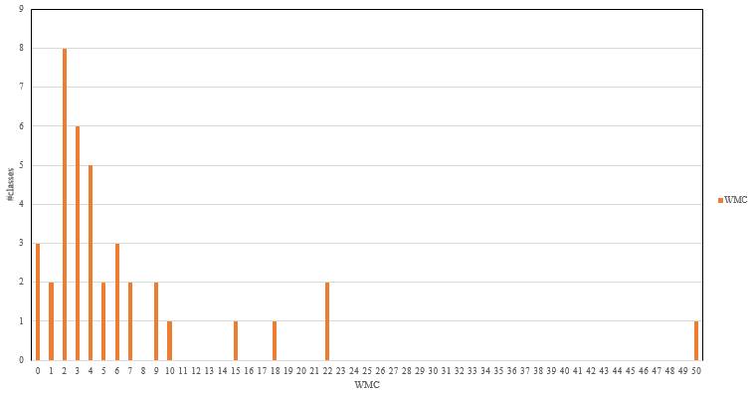
WMC
The 80% of classes in our system with WMC lower than 10, it represents the complexity of our system is quite low. The highest WMC in our system is 50, it’s a great representative for a well-function system.
Notes:
class WMC com.example.elepay.Singleton.DB_Connect 50
com.example.elepay.Strategy.PaymentStrategy 0
com.example.elepay.Iterator.Iterator 0
com.example.elepay.Iterator.Aggregate 0
com.example.elepay.Singleton.ConnectDB 4
com.example.elepay.ChainOfResponsibility.FirstStage 2
com.example.elepay.Template.Verificate_Account 7
com.example.elepay.ChainOfResponsibility.ThirdStage 3
com.example.elepay.Strategy.CreditStrategy 2
com.example.elepay.Template.Verificate_CreditCard 15
com.example.elepay.ChainOfResponsibility.SecondStage 3
com.example.elepay.ChainOfResponsibility.FourthStage 3
com.example.elepay.Strategy.ContextPay 2
com.example.elepay.Strategy.ElePayAccountStrategy 2
com.example.elepay.Memento.CareTaker 5
com.example.elepay.Template.Verificate 6
com.example.elepay.Memento.Originator 4
com.example.elepay.Memento.CreditCardMemento 3
com.example.elepay.State.TransferState 4
com.example.elepay.State.CheckingTransfer 2
com.example.elepay.State.SettingUpTransferInformation 2
com.example.elepay.State.NoTransferInformationFilled 2
com.example.elepay.State.TransferSuccessfully 1
com.example.elepay.Iterator.CreditCardIterator 9
com.example.elepay.ConfirmTransInfoActivity.CreditCardAdapter 3
com.example.elepay.DisplayTransferInfo 4
com.example.elepay.CreditCardActivity.CreditCardAdapter 3
com.example.elepay.ChainOfResponsibility.CalculatingFeedback 4
com.example.elepay.TransferActivity 7
com.example.elepay.State.NoTransferYet 2
com.example.elepay.RegisterActivity 5
com.example.elepay.FirstBindActivity 6
com.example.elepay.State.TransferProcedure 1
com.example.elepay.MainActivity 9
com.example.elepay.CreditCardActivity 22
com.example.elepay.Iterator.CreditCard 18
com.example.elepay.State.TransferControl 6
com.example.elepay.MainFuncActivity 10
com.example.elepay.ConfirmTransInfoActivity 22

Slide 26
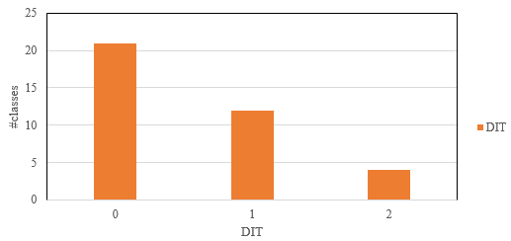
DIT
We can see that most of the DIT is not so high, so the behavior in each class is less affected, because the parent class of a class might redefine some methods used to implement this class.
Notes:
class DIT
com.example.elepay.Singleton.ConnectDB 1
com.example.elepay.ChainOfResponsibility.FirstStage 2
com.example.elepay.Template.Verificate_Account 2
com.example.elepay.ChainOfResponsibility.ThirdStage 2
com.example.elepay.Strategy.CreditStrategy 1
com.example.elepay.Template.Verificate_CreditCard 2
com.example.elepay.ChainOfResponsibility.SecondStage 2
com.example.elepay.ChainOfResponsibility.FourthStage 2
com.example.elepay.Strategy.ContextPay 1
com.example.elepay.Strategy.ElePayAccountStrategy 1
com.example.elepay.Memento.CareTaker 1
com.example.elepay.Template.Verificate 1
com.example.elepay.Memento.Originator 1
com.example.elepay.Memento.CreditCardMemento 1
com.example.elepay.State.TransferState 1
com.example.elepay.State.CheckingTransfer 3
com.example.elepay.State.SettingUpTransferInformation 3
com.example.elepay.State.NoTransferInformationFilled 3
com.example.elepay.State.TransferSuccessfully 3
com.example.elepay.Iterator.CreditCardIterator 1
com.example.elepay.ConfirmTransInfoActivity.CreditCardAdapter 3
com.example.elepay.DisplayTransferInfo 8
com.example.elepay.CreditCardActivity.CreditCardAdapter 3
com.example.elepay.ChainOfResponsibility.CalculatingFeedback 1
com.example.elepay.TransferActivity 8
com.example.elepay.State.NoTransferYet 2
com.example.elepay.RegisterActivity 8
com.example.elepay.FirstBindActivity 8
com.example.elepay.State.TransferProcedure 2
com.example.elepay.MainActivity 8
com.example.elepay.CreditCardActivity 8
com.example.elepay.Singleton.DB_Connect 1
com.example.elepay.Iterator.CreditCard 1
com.example.elepay.State.TransferControl 1
com.example.elepay.MainFuncActivity 8
com.example.elepay.ConfirmTransInfoActivity 8

Slide 27
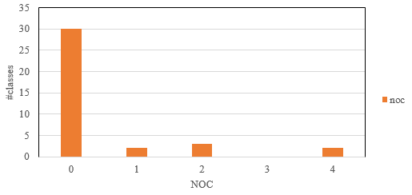
NOC
As the chart above, the values of NOC in our system most are 0, that means the subclasses are affected less by super classes in our system. Therefore, our system performs well on NOC.
Notes:
class NOC
com.example.elepay.Strategy.PaymentStrategy
com.example.elepay.Iterator.Iterator
com.example.elepay.Iterator.Aggregate
com.example.elepay.Singleton.ConnectDB 0
com.example.elepay.ChainOfResponsibility.FirstStage 0
com.example.elepay.Template.Verificate_Account 0
com.example.elepay.ChainOfResponsibility.ThirdStage 0
com.example.elepay.Strategy.CreditStrategy 0
com.example.elepay.Template.Verificate_CreditCard 0
com.example.elepay.ChainOfResponsibility.SecondStage 0
com.example.elepay.ChainOfResponsibility.FourthStage 0
com.example.elepay.Strategy.ContextPay 0
com.example.elepay.Strategy.ElePayAccountStrategy 0
com.example.elepay.Memento.CareTaker 0
com.example.elepay.Template.Verificate 2
com.example.elepay.Memento.Originator 0
com.example.elepay.Memento.CreditCardMemento 0
com.example.elepay.State.TransferState 2
com.example.elepay.State.CheckingTransfer 0
com.example.elepay.State.SettingUpTransferInformation 0
com.example.elepay.State.NoTransferInformationFilled 0
com.example.elepay.State.TransferSuccessfully 0
com.example.elepay.Iterator.CreditCardIterator 0
com.example.elepay.ConfirmTransInfoActivity.CreditCardAdapter 0
com.example.elepay.DisplayTransferInfo 0
com.example.elepay.CreditCardActivity.CreditCardAdapter 0
com.example.elepay.ChainOfResponsibility.CalculatingFeedback 4
com.example.elepay.TransferActivity 0
com.example.elepay.State.NoTransferYet 0
com.example.elepay.RegisterActivity 0
com.example.elepay.FirstBindActivity 0
com.example.elepay.State.TransferProcedure 4
com.example.elepay.MainActivity 0
com.example.elepay.CreditCardActivity 0
com.example.elepay.Singleton.DB_Connect 0
com.example.elepay.Iterator.CreditCard 0
com.example.elepay.State.TransferControl 0
com.example.elepay.MainFuncActivity 0
com.example.elepay.ConfirmTransInfoActivity 0

Slide 28
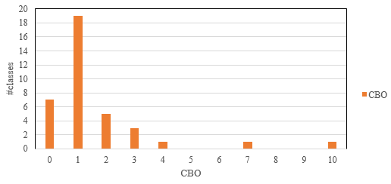
CBO
We can see the most of the CBO is not high here, so it is easier to understand, test, maintain and reuse class. However, the larger the CBO, the harder it is to test.
Notes:
class CBO
com.example.elepay.Strategy.PaymentStrategy
com.example.elepay.Iterator.Iterator
com.example.elepay.Iterator.Aggregate
com.example.elepay.Singleton.ConnectDB 1
com.example.elepay.ChainOfResponsibility.FirstStage 2
com.example.elepay.Template.Verificate_Account 2
com.example.elepay.ChainOfResponsibility.ThirdStage 2
com.example.elepay.Strategy.CreditStrategy 2
com.example.elepay.Template.Verificate_CreditCard 2
com.example.elepay.ChainOfResponsibility.SecondStage 2
com.example.elepay.ChainOfResponsibility.FourthStage 2
com.example.elepay.Strategy.ContextPay 2
com.example.elepay.Strategy.ElePayAccountStrategy 2
com.example.elepay.Memento.CareTaker 2
com.example.elepay.Template.Verificate 3
com.example.elepay.Memento.Originator 3
com.example.elepay.Memento.CreditCardMemento 3
com.example.elepay.State.TransferState 3
com.example.elepay.State.CheckingTransfer 4
com.example.elepay.State.SettingUpTransferInformation 4
com.example.elepay.State.NoTransferInformationFilled 4
com.example.elepay.State.TransferSuccessfully 4
com.example.elepay.Iterator.CreditCardIterator 5
com.example.elepay.ConfirmTransInfoActivity.CreditCardAdapter 5
com.example.elepay.DisplayTransferInfo 5
com.example.elepay.CreditCardActivity.CreditCardAdapter 5
com.example.elepay.ChainOfResponsibility.CalculatingFeedback 5
com.example.elepay.TransferActivity 6
com.example.elepay.State.NoTransferYet 6
com.example.elepay.RegisterActivity 6
com.example.elepay.FirstBindActivity 6
com.example.elepay.State.TransferProcedure 7
com.example.elepay.MainActivity 8
com.example.elepay.CreditCardActivity 10
com.example.elepay.Singleton.DB_Connect 10
com.example.elepay.Iterator.CreditCard 10
com.example.elepay.State.TransferControl 10
com.example.elepay.MainFuncActivity 12
com.example.elepay.ConfirmTransInfoActivity 19

Slide 29
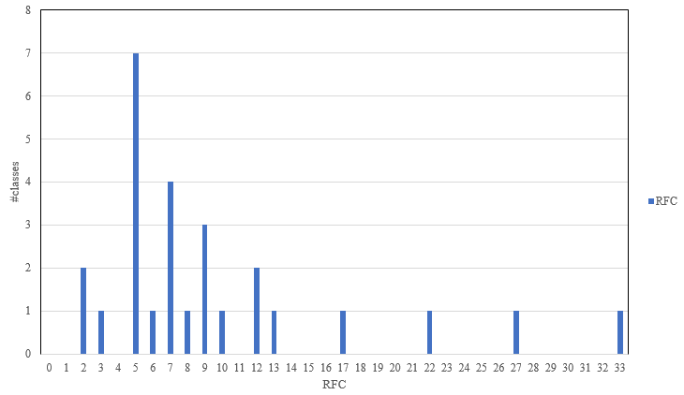
RFC
Most of our class with the RFC lower than 17, because they have less complex relationship. If the RFC is high, then it will take more time to understand and setup the test cases.
Notes:
class RFC
com.example.elepay.Strategy.PaymentStrategy 1
com.example.elepay.Iterator.Iterator 4
com.example.elepay.Iterator.Aggregate 1
com.example.elepay.Singleton.ConnectDB 2
com.example.elepay.ChainOfResponsibility.FirstStage 6
com.example.elepay.Template.Verificate_Account 7
com.example.elepay.ChainOfResponsibility.ThirdStage 6
com.example.elepay.Strategy.CreditStrategy 3
com.example.elepay.Template.Verificate_CreditCard 14
com.example.elepay.ChainOfResponsibility.SecondStage 6
com.example.elepay.ChainOfResponsibility.FourthStage 6
com.example.elepay.Strategy.ContextPay 3
com.example.elepay.Strategy.ElePayAccountStrategy 3
com.example.elepay.Memento.CareTaker 8
com.example.elepay.Template.Verificate 9
com.example.elepay.Memento.Originator 6
com.example.elepay.Memento.CreditCardMemento 3
com.example.elepay.State.TransferState 4
com.example.elepay.State.CheckingTransfer 3
com.example.elepay.State.SettingUpTransferInformation 3
com.example.elepay.State.NoTransferInformationFilled 4
com.example.elepay.State.TransferSuccessfully 3
com.example.elepay.Iterator.CreditCardIterator 10
com.example.elepay.ConfirmTransInfoActivity.CreditCardAdapter 12
com.example.elepay.DisplayTransferInfo 15
com.example.elepay.CreditCardActivity.CreditCardAdapter 12
com.example.elepay.ChainOfResponsibility.CalculatingFeedback 7
com.example.elepay.TransferActivity 29
com.example.elepay.State.NoTransferYet 4
com.example.elepay.RegisterActivity 22
com.example.elepay.FirstBindActivity 25
com.example.elepay.State.TransferProcedure 3
com.example.elepay.MainActivity 25
com.example.elepay.CreditCardActivity 55
com.example.elepay.Singleton.DB_Connect 53
com.example.elepay.Iterator.CreditCard 23
com.example.elepay.State.TransferControl 10
com.example.elepay.MainFuncActivity 26
com.example.elepay.ConfirmTransInfoActivity 65

Slide 30
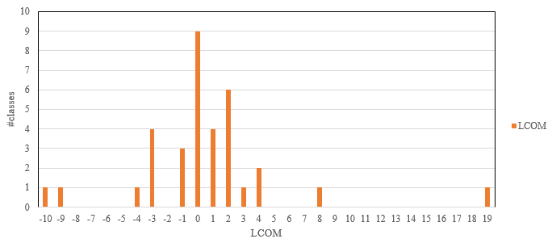
LCOM
LCOM is the lower the better. As the chart above, LCOM most are between -3 to 2, that means it is high cohesion. Therefore, this is a good design.
Notes:
class LCOM
com.example.elepay.Template.Verificate 19
com.example.elepay.Singleton.ConnectDB 0
com.example.elepay.ChainOfResponsibility.FirstStage 0
com.example.elepay.Template.Verificate_Account 3
com.example.elepay.ChainOfResponsibility.ThirdStage 0
com.example.elepay.Strategy.CreditStrategy 0
com.example.elepay.Template.Verificate_CreditCard 4
com.example.elepay.ChainOfResponsibility.SecondStage 0
com.example.elepay.ChainOfResponsibility.FourthStage 0
com.example.elepay.Strategy.ContextPay 1
com.example.elepay.Strategy.ElePayAccountStrategy 1
com.example.elepay.Memento.CareTaker -3
com.example.elepay.Memento.Originator -4
com.example.elepay.Memento.CreditCardMemento -3
com.example.elepay.State.TransferState 4
com.example.elepay.State.CheckingTransfer 2
com.example.elepay.State.SettingUpTransferInformation 2
com.example.elepay.State.NoTransferInformationFilled 2
com.example.elepay.State.TransferSuccessfully 0
com.example.elepay.Iterator.CreditCardIterator -9
com.example.elepay.ConfirmTransInfoActivity.CreditCardAdapter 1
com.example.elepay.DisplayTransferInfo -1
com.example.elepay.CreditCardActivity.CreditCardAdapter 1
com.example.elepay.ChainOfResponsibility.CalculatingFeedback 2
com.example.elepay.TransferActivity 2
com.example.elepay.State.NoTransferYet 0
com.example.elepay.RegisterActivity -1
com.example.elepay.FirstBindActivity 1
com.example.elepay.State.TransferProcedure 0
com.example.elepay.MainActivity -1
com.example.elepay.CreditCardActivity -10
com.example.elepay.Singleton.DB_Connect 1
com.example.elepay.Iterator.CreditCard 8
com.example.elepay.State.TransferControl 2
com.example.elepay.MainFuncActivity -3
com.example.elepay.ConfirmTransInfoActivity -3

Slide 31
The number of classes :
We have 37 classes in our ElePay system.
The number of inheritances :
There are 12 inheritance in our ElePay system, that are Verificate_Account、Verificate_CreditCard、FirstStage…….(other)
The number of aggregations :
There are 3 aggregations in our ElePay system, that are ConnectDB、TransferControl、CareTaker.

Slide 32
The number of associations :
There are 28 associations in our ElePay System, that are
Verificate 、 ComfirmTransInfoActivity、CalculatingFeedback…. (other)
Functions of your design for two teamwork :
In teamwork2 we add additional functions like transfer can choose which way you want to pay and if you choose creditCard ,
You can choose which card you want to pay
You can management your creditCard, add, remove, update…
If you did wrong, you can undo and redo the steps
Transfer add an AOTP verification process
When you in process, the system will display the transfer state
At the end, the system will display transfer detail
It can count how many credit card you have.

Slide 33
Three pieces of the needed changes
The first pieces:
TranferControl depends on TransferState,
so if TransferState change, TranferControl will change.
For example,
if we add a longClick() method in TransferState,
then TransferControl need to add a longClick() method too.

Slide 34
Three pieces of the needed changes
2. The second pieces:
SettingUpTransferInformation depends on TransferProcedure,
and TransferProcedure depends on TransferState,
so if TransferState change,
TransferProcedure and SettingUpTransferInformation will changes.
For example,
if we add a pressCancel() method in TransferProcedure,
then SettingUpTransferInformation need to add a pressCancel() method.

Slide 35
Three pieces of the needed changes
3. The third pieces:
CreditCardIterator depends on Iterator, so if Iterator changes, CreditCardIterator will change.
For example,
if we add or remove a method,
then CreditCardIterator need to add or remove a method too..

Slide 36
THANK YOU

